Slide 1
Self-Service
Notes:
Recommended Facilitation Time: 30 mins

Slide 2
Enabling Objectives
IDENTIFY the functions of MyNavy Portal (MNP)
IDENTIFY the functions of MNP Sailor Landing Page
DEFINE the purpose of MyNavy Assignment (MNA)
IDENTIFY the functions of BUPERS Online (BOL)
DEFINE the purpose of Career Waypoints (CWAY) Self-Service
Define the purpose of Job Opportunities in the Navy (JOIN)
IDENTIFY the functions of Navy Standard Integrated Personnel System (NSIPS)
Notes:
FACILITATOR GUIDE:
Review objectives

Slide 3
References
My Navy Assignment
  https://mynavyassignment.navy.mil/mna/Index.action
BUPERS Online
  https://www.bol.navy.mil/BAM/
Navy Standard Integrated Personnel System
  https://www.nsips.cloud.navy.mil/nsipsclo_landing/index.html
MyNavy Portal
  https://my.navy.mil/index.html
Notes:
FACILITATOR GUIDE:
Review references

Slide 4
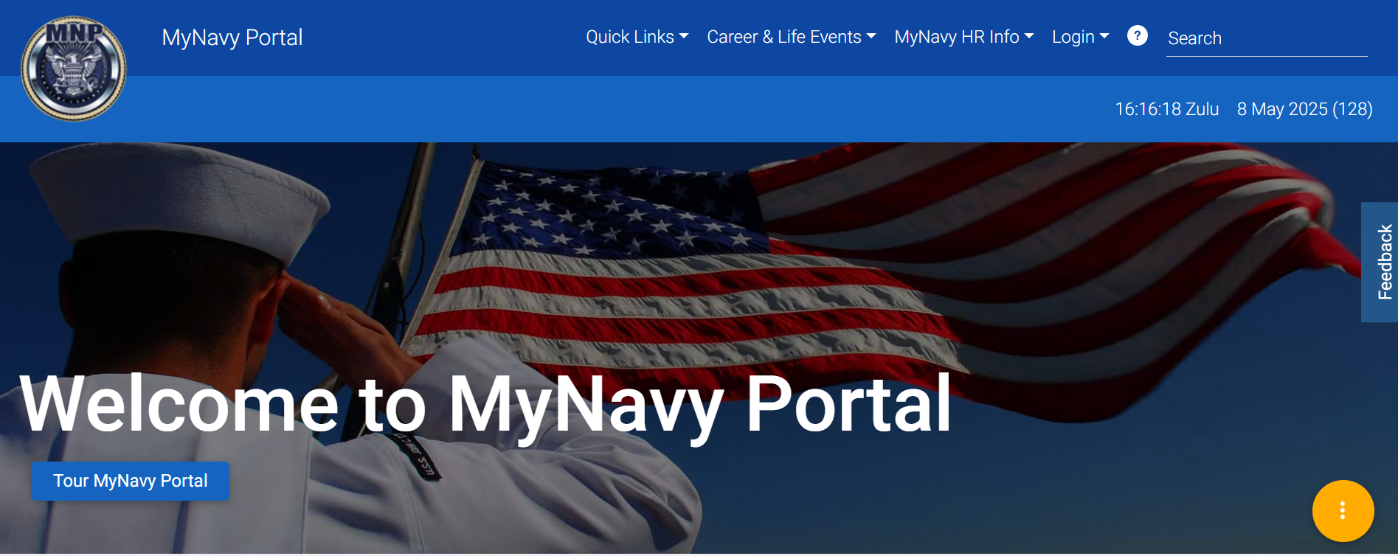
MyNavy Portal (MNP)
Homepage
Notes:
FACILITATOR GUIDE:
Quick Links: A convenient section for sailors to access various Navy websites and programs, such as NSIPS, BOL, MNA, MyNavyHR, and more.
Career & Life Events: Important career milestones and life events updates for sailors.
MyNavy HR Info & Sailor Landing Page Login: Direct access to MyNavy HR information and the Sailor Landing Page login

Slide 5
MyNavy Portal (MNP)
Single point of entry for Sailors to manage their careers.
MyNavy Career Center
E-Leave (NSIPS)
MyPCS (Permanent Change of Station)
Checklist Electronic Personnel Action Request (ePAR/1306)
Physical Readiness Management System (PRIMS)
Career & Life Event Content
Joint Service Transcripts
MyNavy Education
Enlisted Advancement Bibliographies
Notes:
FACILITATOR GUIDE:
Briefly touch on each item and what they are. Do not go into depth as several are further explained in the brief.

Slide 6
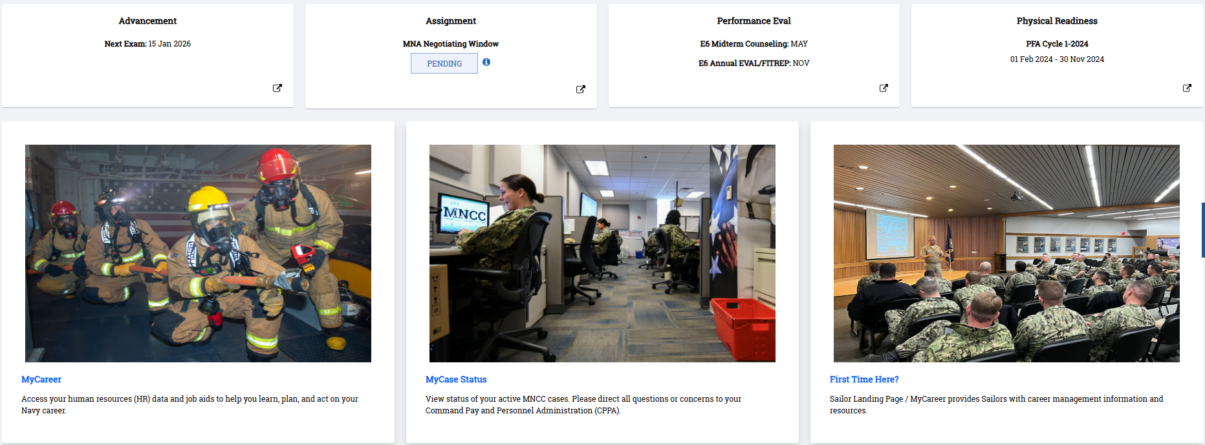
MyNavy Portal (MNP)
Sailor Landing Page
Notes:
FACILITATOR GUIDE:
Sailor Landing Page: Provides key information including your upcoming advancement exam date, the current phase of MyNavy Assignment, due dates for evaluations and midterms, and the current Physical Readiness Cycle.
MyCareer: allows Sailors to view human resources (HR) data and job aids to support Career & Life Event tasks.
MyCase Status: allows users to view status of MyNavy Career Center (MNCC) service requests.

Slide 7
MyNavy Assignment
Web-based system that allows Sailors to:
  View and apply for available billets
  Conversions are initiated through MNA unless it requires a package
  View detailing milestones
  Communicate with Detailers
  Update resume and preferences
  PACT Sailors have ability to choose rating designation through MNA
Notes:
FACILITATOR GUIDE:
MyNavy Assignment (MNA) is designed and used by Sailors, Command Career Counselors, and command personnel. The Web-based system allows Sailors to view available billets and make applications. MNA provides Sailors more options, greater career flexibility and increased transparency. MNA supports MyNavy HR goals to transform MNHR, deliver Sailor 2025, and man the fleet to support a 21st Century fighting force.
AC/TAR Sailors applying for Reenlistment and Conversion apply in My Navy Assignments during their PRD window.

Slide 8
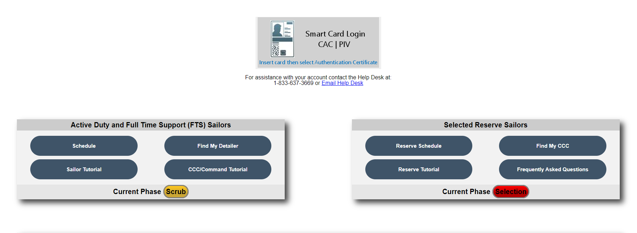
MyNavy Assignment
Login Page
https://mynavyassignment.dc3n.navy.mil/mna/Index.action
Notes:
FACILITATOR GUIDE:
Emphasize the tutorial, schedule, detailer contact info, and resources.

Slide 9
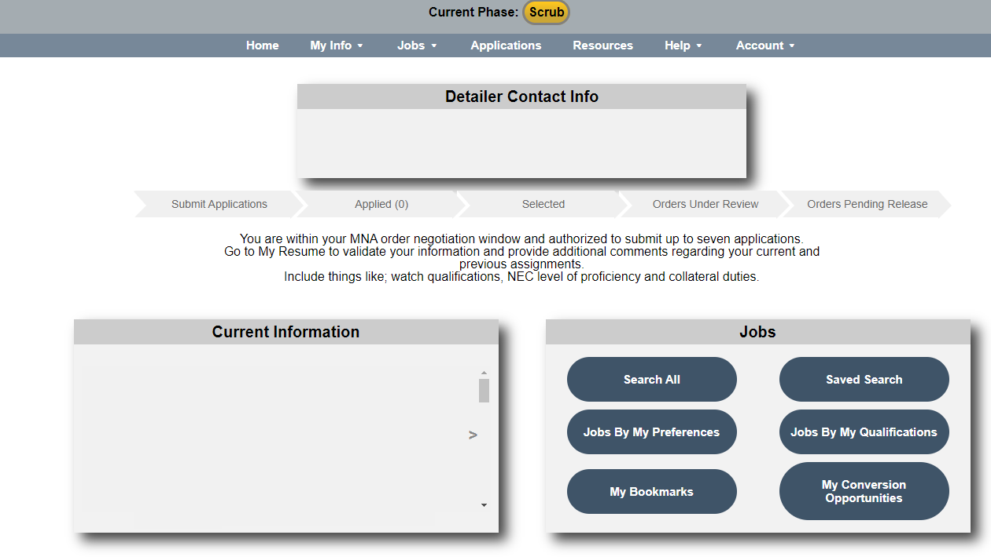
MyNavy Assignment
Homepage
Notes:
FACILITATOR GUIDE:
Displays detailer current information, additional notes from detailer, Sailors information, application history, and recourses
ADDITIONAL NOTES:
The Sailor Conversion Opportunities Page (SCOP) is gateway to MNA’s added conversion functionality. Job conversion opportunities are filtered based on Year Group and a Sailor’s personal information.
My Resume provides a snapshot of service record to highlight professional skills, personal details and experience.
The Sailor Resume page details information such as: Assignment History, NECs, Warfare, Professional Information, Education and Language Performance Data, Physical Fitness, Family Information, and Resume Comments.
Touch on why it's important for members to have updated contact information and update preferences prior to going into their window. Recommended to update 18 months prior to PRD.

Slide 10
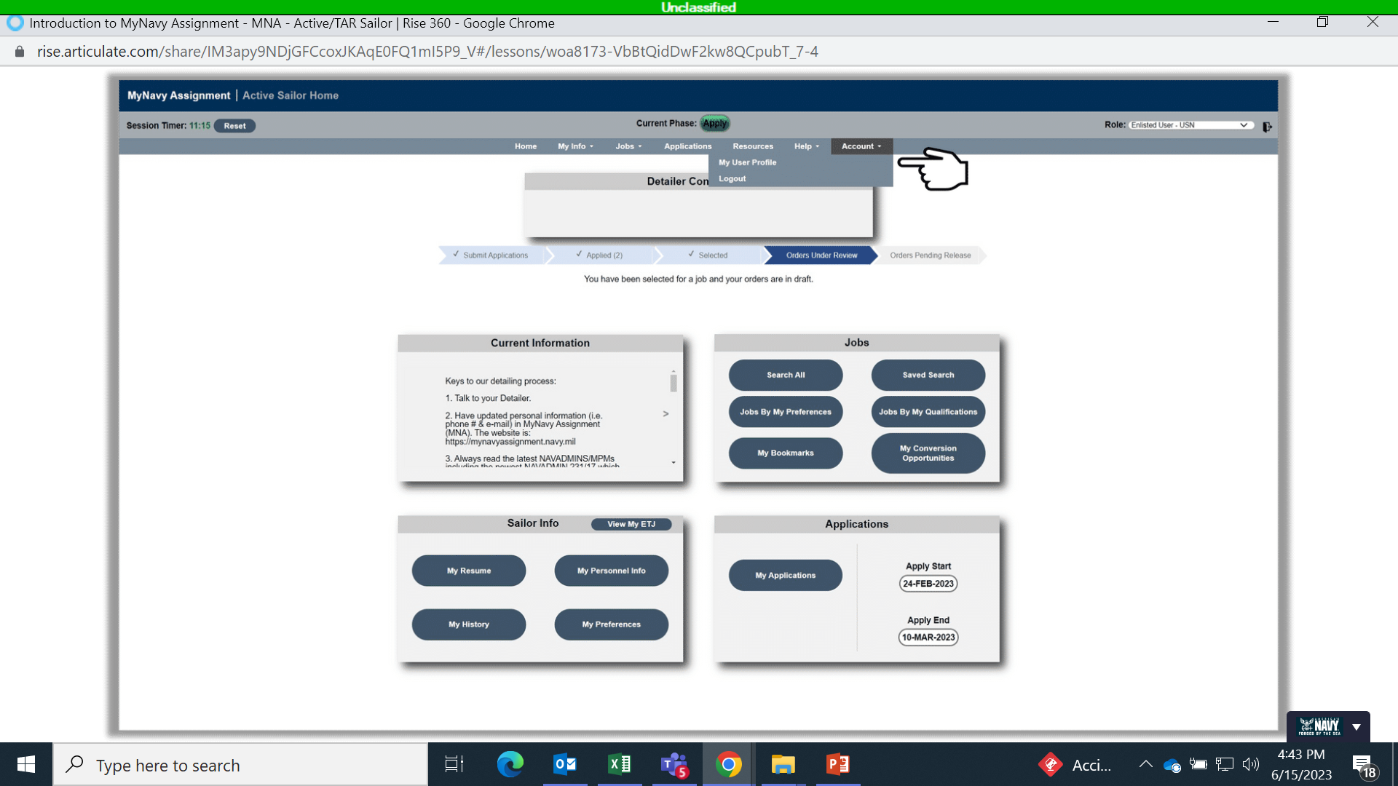
MyNavy Assignment
Homepage
Notes:
FACILITATOR GUIDE:
Provides access to personnel searches and individual personnel data including My Sailor Info, My Career History, My Alert History, My Preferences, and My Resume.
**Explain the fields:
Sailor Info
JOBs
My applications
My conversion opportunities

Slide 11
BUPERS Online
(BOL)
A single point of entry application for logging into numerous web-based applications.
  CWAY Self-Service
  Official Military Personnel File (OMPF)
  Personnel Summary Records (PSR I, II, III)
  Individual Medical Readiness (IMR) status
  Navy Personnel Command Document Services
    Name Change
    Letter to the Selection Board
    Personal and Unit Award Search
Notes:
FACILITATOR GUIDE:
NONE

Slide 12
Job Opportunities in the Navy
(JOIN) Survey
A tool that helps recruits and sailors make decisions about choosing or changing their rating by assessing their interests
Uses the connection between different ratings and their key traits to match your skills and interests, helping recommend the best job options for you
  Community (e.g., Submarine, Surface Aviation)
  Environment/Work Style (e.g., indoor/outdoor)
  Work Activities (e.g., Repair-Electronic, Maintain-Electronic)
Notes:
FACILITATOR GUIDE:
Applies to all Sailors matching Sailors interests with their aptitudes.

Slide 13
Career Waypoints
(C-WAY)
Used to match qualification data of Sailors to Fleet requirements
Providing qualifications for MNA to fill billets/convert rate
Track and update qualifications for OBLISERV via MNA
SELRES applications are submitted or created
4/2/2 Sailor MSO time remaining and tracking
Component changes
RC lateral rate conversions
PACT Marketplace
Notes:
FACILITATOR GUIDE:
-Component changes include: (Active Component (AC)/Training and Administration of Reserve (TAR)/Selected Reserves)
AC/TAR to SELRES; SELRES to AC/TAR
-SELRES applications are made via CWAY, with auto-created applications for those with remaining MSO for 4+2+2 sailors.
-PACT Marketplace- used to track PACT intentions and designation progress

Slide 14
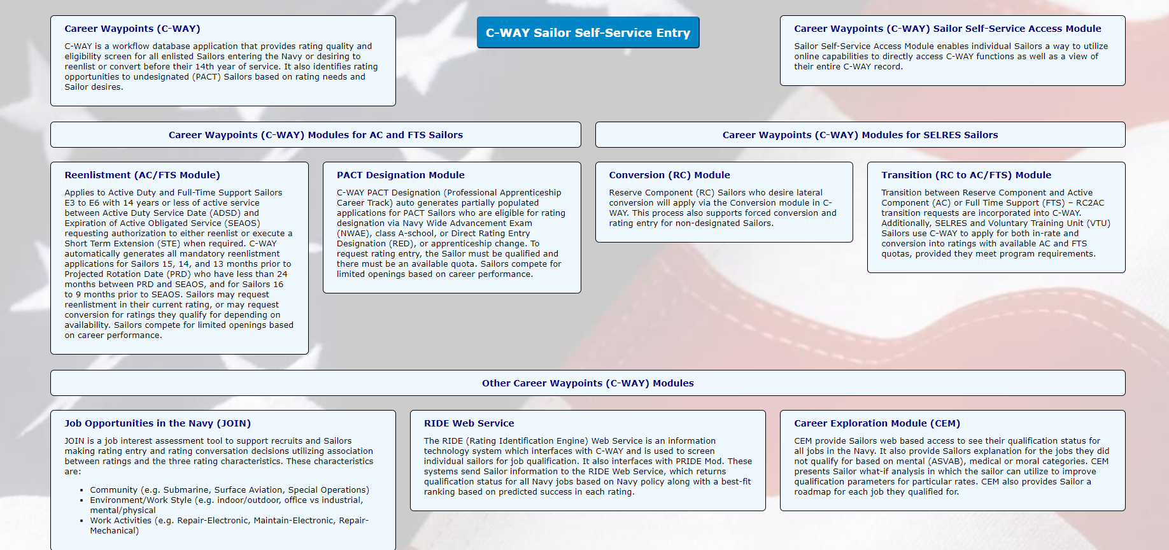
Career Waypoints
(C-WAY)
Notes:
FACILITATOR GUIDE:
The Sailor Self-Service Access enables individual Sailors with an internet connection and a common access card (CAC) to directly access C-WAY functions, as well as view their entire C-WAY record.

Slide 15
Career Waypoints
(C-WAY)
Self-Service
My Opportunities
View qualified jobs
PACT qualification
Career Exploration Module (CEM)
My Interests
View JOIN Assessment results
Notes:
FACILITATOR GUIDE:
Please state the purpose of CWAY Self-service and where Sailors can find it?
ANSWER:
Corporate Information Technology system which provides a mechanism for matching personnel inventory to requirements with the best performing Sailors/BOL.

Slide 16
Navy Standard Integrated Personnel System
(NSIPS)
Record of Emergency Data/Dependency Application (RED/DA) updates
Electronic Service Record (ESR)
  Member Data Summary (MDS)
  Orders
  History of Assignments
  Honors and Awards
  Training, Education, and Qualifications
  Montgomery GI Bill Election
E-Leave
Enlisted Advancement Worksheet (EAW)
Continuation Pay
Notes:
FACILITATOR GUIDE:
Sailors should verify their record at least annually and after every reenlistment for accuracy
Montgomery GI Bill Elections can be submitted between 180 and 270 days after the service members Active Duty Service Date.

Slide 17
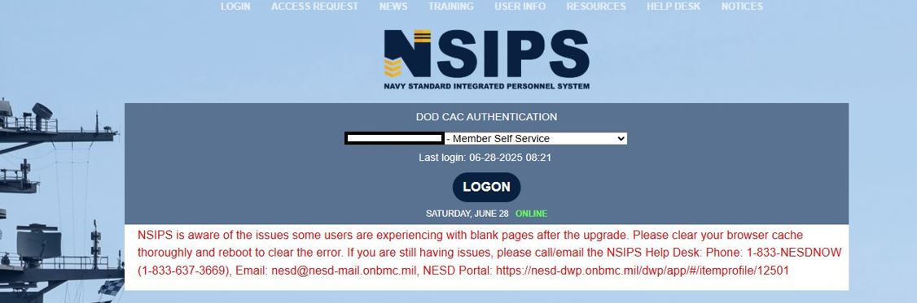
Navy Standard Integrated Personnel System
(NSIPS)

Slide 18
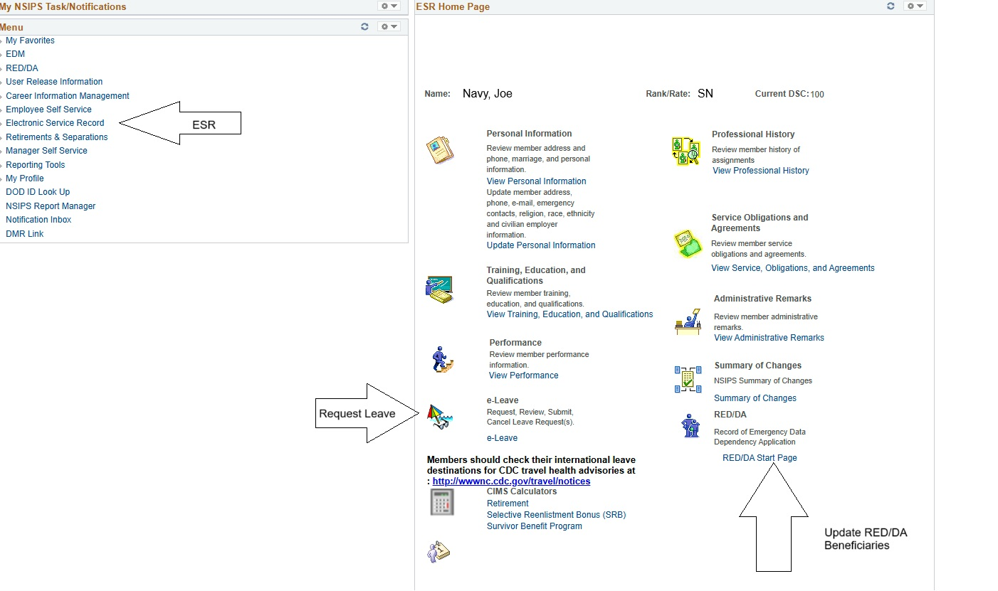
Notes:
Walk members through the features of NSIPS Self service:
ESR (eLeave/RED DA/EAW/Montgomery GI BILL election/CDB)
Career Information Management (Retirement/SRB/ESRP Calculator)
Go over updating email/address/phone number. Why it is important!

Slide 19
Knowledge Check
Who is affected by CWAY?
What is the purpose of the JOIN survey?
What are some of the items you can view in BOL?
What is the purpose of MyNavy Assignment?
What are some things you can view on the Sailor Landing Page in my Navy Portal?
What is the timeframe to elect in or out of the Montgomery GI Bill?
Notes:
Who is affected by CWAY?
ANSWER: Paygrades E3-E6, with 14 years or less of active service between their active-duty service date (ADSD) and their current expiration of active obligated service (SEAOS) require CWAY quotas for retention; PACT Sailors; and component changes (AC2RC, RC2AC)
2. What is the purpose of the JOIN survey?
ANSWER: Job interest assessment tool that supports recruits and Sailors making rating entry and rating conversation decisions.
3. What are some of the items you can view in BOL?
ANSWER: CWAY/CWAY Self-Service, Official Military Personnel File (OMPF), Personnel Summary Records (PSR I, II, III), eNAVFIT, Individual Medical Readiness (IMR) status, Navy Personnel Command Document Services, Name Change, Letter to the Selection Board, and Award locator
4. What is the purpose of MyNavy Assignment?
ANSWER: Web-based system that allows Sailors to view/apply for available jobs, as well as apply for conversion opportunities
5. What are some things you can view on the Sailor Landing Page in MyNavy Portal?
ANSWER: Sailor Profile, Important dates, Advancement dates, MNA negiotiation window, Performance Eval due dates, Physical Readiness date, eLeave, 1306/7, View case status via MNCC.
6. What is the timeframe to elect in or out of the Montgomery GI Bill?
ANSWER: Between 180 and 270 days after the service members Active Duty Service Date (ADSD).

Slide 20
Review and Summary
My Navy Portal (MNP)
MNP Sailor Landing Page
My Navy Assignment (MNA)
BUPERS Online (BOL)
Career Waypoints (CWAY)
Job Opportunities in the Navy (JOIN)
Navy Standard Integrated Personnel System (NSIPS)
Notes:
Who is affected by CWAY?
ANSWER: Paygrades E3-E6, with 14 years or less of active service between their active-duty service date (ADSD) and their current expiration of active obligated service (SEAOS) require CWAY quotas for retention; PACT Sailors; and component changes (AC2RC, RC2AC)
2. What is the purpose of the JOIN survey?
ANSWER: Job interest assessment tool that supports recruits and Sailors making rating entry and rating conversation decisions.
3. What are some of the items you can view in BOL?
ANSWER: CWAY/CWAY Self-Service, Official Military Personnel File (OMPF), Personnel Summary Records (PSR I, II, III), eNAVFIT, Individual Medical Readiness (IMR) status, Navy Personnel Command Document Services, Name Change, Letter to the Selection Board, and Award locator
4. What is the purpose of MyNavy Assignment?
ANSWER: Web-based system that allows Sailors to view/apply for available jobs, as well as apply for conversion opportunities
5. What are some things you can view on the Sailor Landing Page in MyNavy Portal?
ANSWER: Sailor Profile, Important dates, Advancement dates, MNA negiotiation window, Performance Eval due dates, Physical Readiness date, eLeave, 1306/7, View case status via MNCC.
6. What is the timeframe to elect in or out of the Montgomery GI Bill?
ANSWER: Between 180 and 270 days after the service members Active Duty Service Date (ADSD).

Slide 21
Questions?
Notes:
FACILITATOR GUIDE:
Questions to ask the class:
What is the purpose of a CDB? What is the CDB Schedule? What is the PACT CDB Schedule? How many years is your MSO? Where to find LaDR? Timelines for TAPS?
Presenter can tailor review questions to the audience.

